Slide 1
Maintaining Documents and Macros
Microsoft Word 2013
Lesson 12

Slide 2
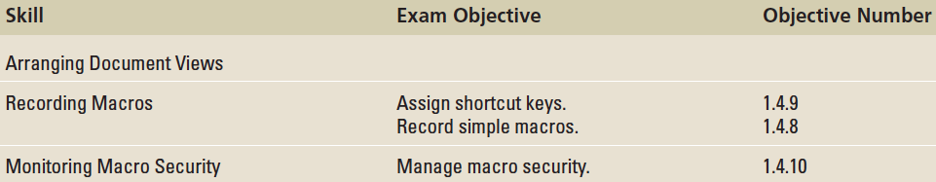
Objectives

Slide 3
Step by Step: Save the Master Document
OPEN the Hosting document from lesson folder.
To save the document in a specific folder, click the Save As button. The Save As dialog box opens for you to locate your flash drive.
Click the New folder button located under the address bar and type Master Hosting and press Enter to accept the new folder name.
With the folder selected, click the Open button or double-click to place the master folder in the address bar.

Slide 4
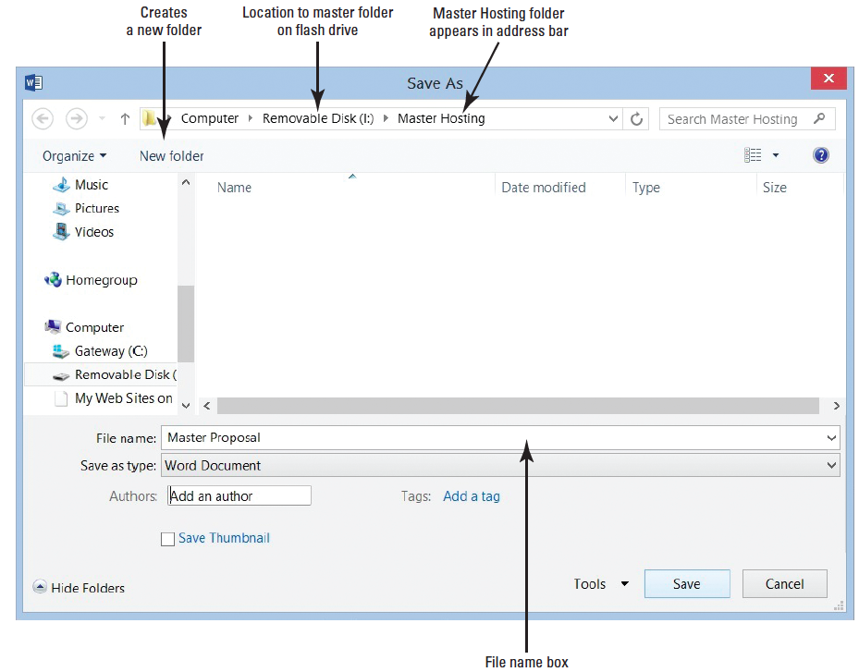
Step by Step: Save the Master Document
Creating a folder is easy and makes your job easier to locate the master document and subdocuments. When naming a folder, choose a name closely related to the document.
In the File name box, type Master Proposal.
The figure at right displays the file in the folder.
Click the Save button to save the document in the Master Hosting folder.
PAUSE. LEAVE the document open for the next exercise.
Notes:
Cross Reference: Creating and saving documents is covered in Lesson 1.

Slide 5
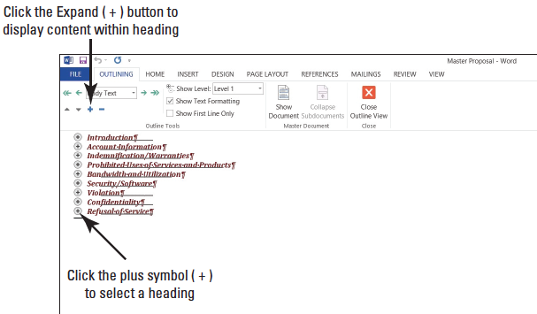
Step by Step: Create Subdocuments
USE the document open from the previous exercise.
Click the View tab in the Views group, and then click the Outline button. The Outlining tab opens and is placed by the Home tab.
In the Outline Tools group, click the drop- down arrow by Show Level and select Level 1 to make the document more manageable. This document has already been formatted with heading styles; when the levels are changed, the document collapses and only Level 1 displays on the screen as shown above.

Slide 6
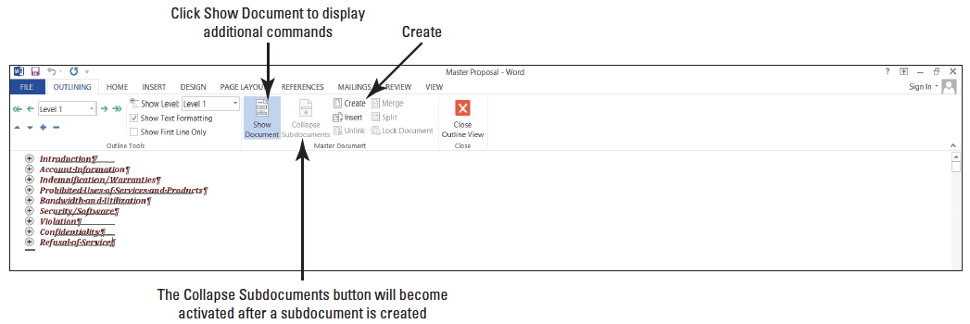
Step by Step: Create Subdocuments
In the Master Document group, click the Show Document button to display additional commands as shown below.
Click the plus (+) symbol next to Introduction to select the heading. Even though you cannot see it, the content within the heading is also selected.

Slide 7
Step by Step: Create Subdocuments
Click the Create button in the Master Document group to create a subdocument. Notice that Introduction has a subdocument icon on the left side and is surrounded by a border with a continuous section break above and below the heading. This allows Word to distinguish the beginning and end of a subdocument with a continuous flow to the master document. A border indicates this is a subdocument. With your first subdocument created, the Collapse Subdocuments button becomes activate. If you cannot see the continuous section break, select the Show/Hide ( ¶ ) button from the Home tab.
Select the plus (+) symbol next to the Account Information heading, and then click the Create button. A border is automatically placed around the subdocument.
Notes:
Cross Reference: Section breaks are covered in Lesson 5.

Slide 8
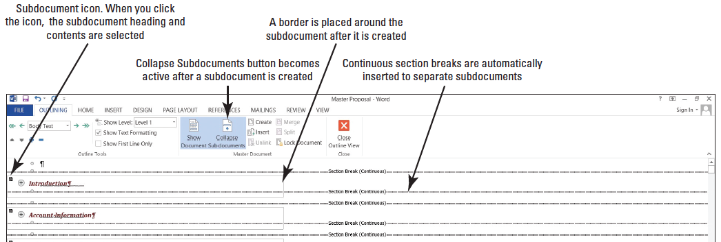
Step by Step: Create Subdocuments
Repeat your steps for the remaining headings: Indemnification/Warranties, Prohibited Uses of Services and Products, Bandwidth and Utilization, Security/Software, Violation, Confidentiality, and Refusal of Service. The document should display as shown below. A border appears around each subdocument along with continuous section breaks.
PAUSE. LEAVE the document open to use in the next exercise.

Slide 9
Step by Step: Save Subdocuments
USE the document that is open from the previous exercise.
Click the SAVE button on the Quick Access Toolbar to save the Master Proposal document and the created subdocuments.
Word saves each subdocument as a separate file based on the heading style (Heading 1) that was applied to the document. Each of the subdocuments are linked to the master document.
CLOSE the master document.
PAUSE. LEAVE Word open.

Slide 10
Step by Step: View the Subdocuments in the Master Folder
OPEN the Master Hosting folder. You started with one file in your Master Hosting folder and now you have several subdocuments in the folder. When subdocuments are created and then saved, Word automatically saves each subdocument as a separate file. Word uses the text within the heading as the filename.
OPEN the Master Proposal document. The document opens in Print Layout view. When opening a master document, the subdocuments shows the location in a hyperlink to the file. You see your flash drive letter followed by the Master Hosting folder and then by the subdocument filename. By default the subdocuments are locked and collapsed.

Slide 11
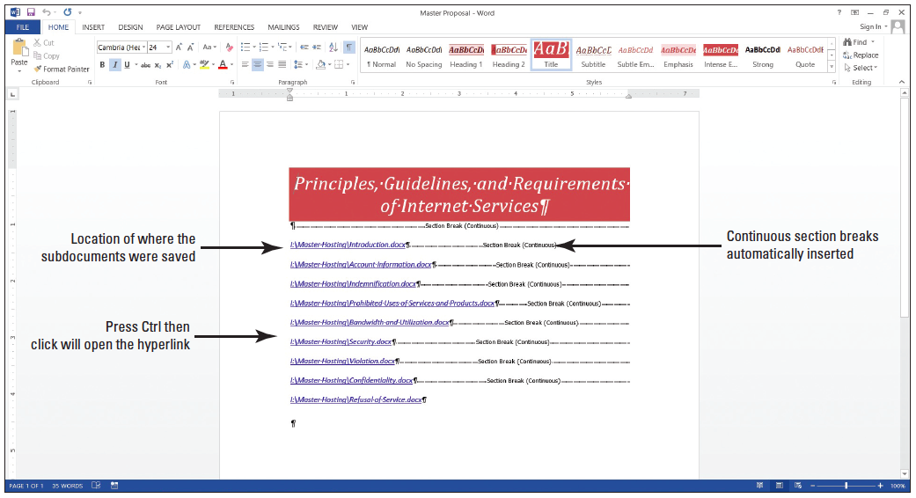
Step by Step: View the Subdocuments in the Master Folder
The figure below displays the document with the location of the saved subdocuments with hyperlinks.

Slide 12
Step by Step: View the Subdocuments in the Master Folder
When you are ready to follow a link in Word, press Ctrl, and then Click. Each hyperlink goes directly to the subdocument when you click on the link. Later in this lesson, you open a subdocument.
PAUSE. LEAVE the document open to use in the next exercise.

Slide 13
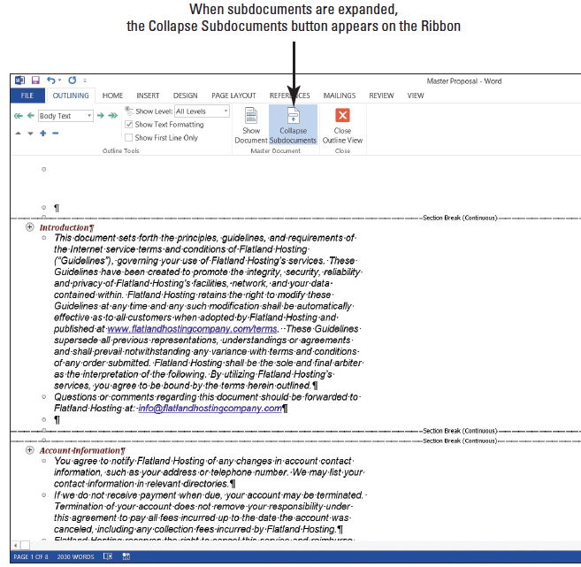

Step by Step: Expand and Collapse Subdocuments
USE the document that is open from the previous exercise.
Change the view of the document to Outline. With the Outlining tab open, you can now work with the buttons in the Master Document group.
Click the Expand Subdocuments button and notice that all subdocuments are shown along with their contents (right).

Slide 14
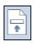
Step by Step: Expand and Collapse Subdocuments
Each heading and its contents now appear. Now that the subdocuments are expanded the Expand Subdocuments button is replaced with the Collapse Subdocuments button.
Click the Collapse Subdocuments button to collapse each of the subdocuments. The Expand Subdocuments button appears again.
PAUSE. LEAVE the document open to use in the next exercise.
Notes:
Troubleshooting: If you do not see the headings and contents in a border, click the Show Documents button in the Master Documents group.

Slide 15

Step by Step: Promote and Demote Subdocuments
USE the document that is open from the previous exercise.
Click the Expand Subdocuments button to expand all subdocuments. Point at the plus (+) symbol next to the Account Information heading—notice that the mouse pointer changes to four arrows.
Click the plus (+) symbol once to select the heading and all the contents within the subdocument.
In the Outline Tools group, click the Demote button once.

Slide 16
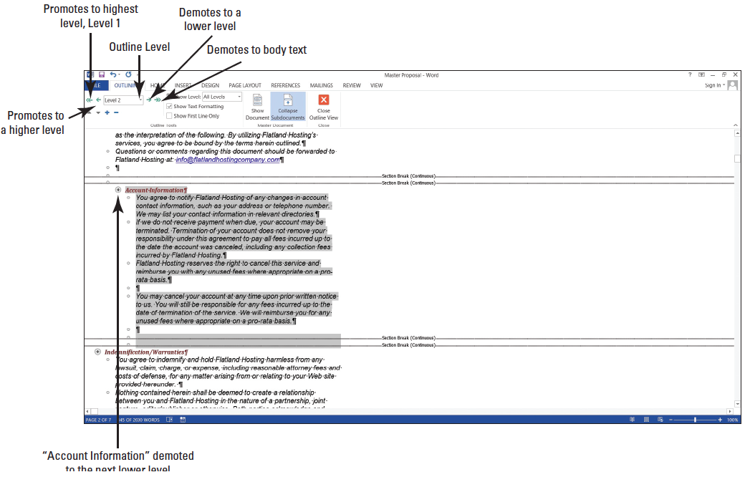
Step by Step: Promote and Demote Subdocuments
Did you see the Outline Level box change from a Level 1 to a Level 2? The Account Information has been demoted to a Level 2 as shown at right.
With the Account Information subdocument still selected, click the Promote arrow once.

Slide 17
Step by Step: Promote and Demote Subdocuments
The Account Information has been promoted back to a Level 1. Demote back to a Level 2.
Click the Save button on the Quick Access Toolbar. The master document is saved with the updated changes.
PAUSE. LEAVE the document open to use in the next exercise.
Notes:
Another Way: You can click the drop-down arrow by the Outline Level box to select the level.

Slide 18
Step by Step: Reorganize Subdocuments
USE the document that is open from the previous exercise.
Deselect Account Information by clicking in a blank area of the document screen.
Add a check mark next to Show First Line Only.
This displays a few lines for each of the subdocuments and hides the remaining content—making the subdocuments more manageable.
Scroll down and click to select the plus (+) symbol by the Security/Software heading and its contents.

Slide 19
Step by Step: Reorganize Subdocuments
Click Show Documents button to display the additional commands in the Master Document group.
On the Outline Tools group, click the Move Down button (four times) until the heading is positioned below the continuous section break below Violation.
Delete the two continuous section breaks under Security/Software and Confidentiality.
Deleting these continuous section breaks makes it easy to unlink the subdocuments.
PAUSE. LEAVE the document open to use in the next exercise.
Notes:
Another Way: Click the subdocument icon to select the heading and contents, and drag and drop in the new location.

Slide 20
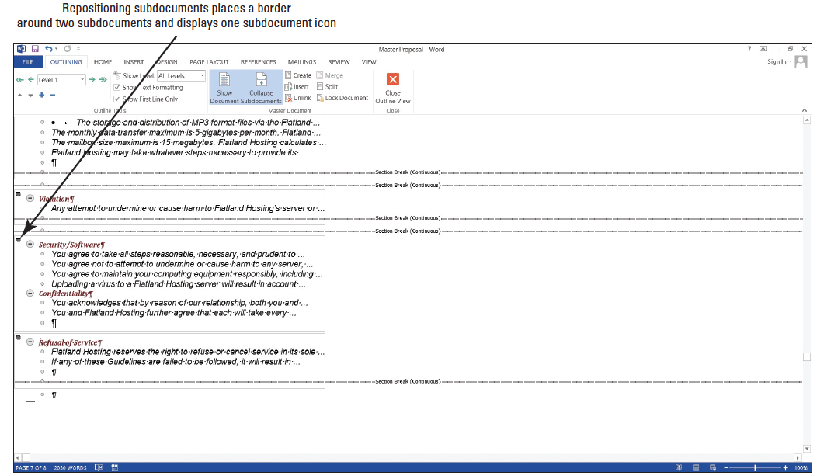
Step by Step: Unlink Subdocuments
USE the document that is open from the previous exercise.
Currently, there is only one subdocument icon for both levels as shown below. Both of these subdocuments are linked to the master document and must be unlinked to create separate subdocuments.

Slide 21
Step by Step: Unlink Subdocuments
Click the plus (+) symbol by Security/Software to select it, and then click the Unlink [Prod: insert MA1208.jpg here] button.
The subdocument icon disappears.
Click the Create button to create a subdocument.
This places a border around this level and the subdocument icon appears.
Click the plus (+) symbol by Confidentiality.
Check whether the Unlink button is showing. If it is, then click Unlink, and then click Create. If the Unlink button is not displayed, click just the Create button.
Click the check box to turn off Show First Line Only. Change the Level to display only Level 1.

Slide 22
Step by Step: Unlink Subdocuments
Changing the display of the level makes it more manageable to create a subdocument and see the borders around each of the subdocuments.
Click the Collapse Subdocuments button and a prompt appears asking Do you want to save changes to the master document “Master Proposal”. Click OK.

Slide 23
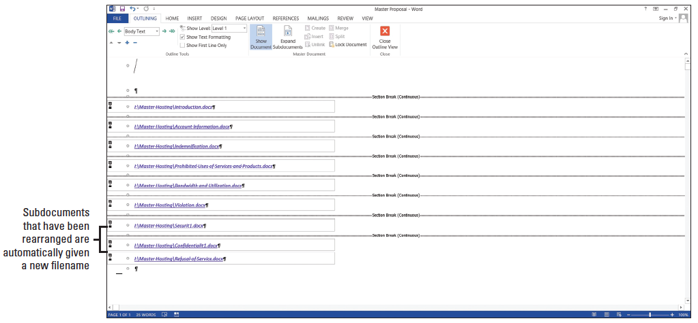
Step by Step: Unlink Subdocuments
Your screen should match the figure below. Word automatically saves the subdocument with a new filename and drops the last character of the filename and adds an 1 at the end.

Slide 24
Step by Step: Unlink Subdocuments
The two additional files that you see in your flash drive are Securit1 and Confidentialit1.
Each time you create a subdocument, it is automatically linked to the master document and the original subdocuments are no longer linked to the master document.
PAUSE. LEAVE the document open to use in the next exercise.

Slide 25
Step by Step: Edit an Individual Subdocument
Subdocuments can be edited directly in the master document, or you can open the subdocument as a separate file in its own window.
USE the document that is open from the previous exercise.
Point to the Master Hosting\Introduction subdocument hyperlink, press Ctrl and Click to follow the hyperlink and open the subdocument in a separate window. It is now ready for editing and formatting.
You will edit text in the first and second sentences. Select principles, guidelines, and requirements from the first sentence. In the second sentence, select integrity, security and reliability, and privacy. All seven words should be selected.
Notes:
Cross Reference: In Lesson 2, you learn to select text using different methods. To select multiple text, press CTRL and click text.

Slide 26
Step by Step: Edit an Individual Subdocument
Bold the selected text, and then change the font color to dark red.
Click Save on the Quick Access Toolbar; then close the Introduction subdocument file.
If prompted to save changes, click SAVE.
Click the Outlining tab to make it available with its commands.
In the Master Document group, click the Expand Subdocument button. Notice the bolded dark red text under the Introduction heading. Changes made in the Introduction subdocument automatically update the master document.

Slide 27
Step by Step: Edit an Individual Subdocument
Click the Close Outline View button to take you to the Print Layout view.
Scroll down to page 3.
Under the heading, Prohibited Uses of Services and Products, select the second paragraph.
From the Design tab, select Page Borders.
Add a border around the paragraph by selecting the Borders tab to make it active.
Under the Setting section, select Shadow. Change the Width to 2¼, and thenb apply Red, Accent 2 color. A colored border with a 2¼ width is applied to the paragraph.

Slide 28
Step by Step: Edit an Individual Subdocument
Click the Shading tab, and then select the fill color Red, Accent 2, Lighter 80%. A shading is applied to the paragraph within the border.
Click OK.
Under the headings, General, System and Network, and Billings, select the contents with bullets.
Change the bullets to the solid diamond. The bullets have been replaced with the new bullets on the selected text.
SAVE the Master Proposal document, and then close the file. You have completed editing the master document.
To view an independent subdocument, open the

Slide 29
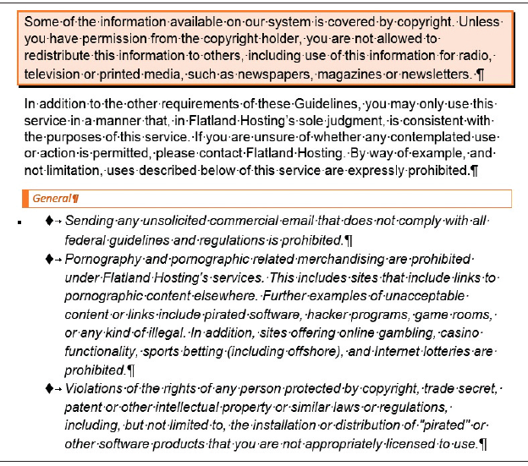
Step by Step: Edit an Individual Subdocument
Prohibited Uses of Services and Products subdocument from the Master Hosting folder. The changes that you made in steps 10–15 are shown in the subdocument as shown at right.
CLOSE the document.
LEAVE Word open.

Slide 30
Step by Step: Assign Shortcut Keys
A keyboard shortcut is a combination of two or more keys to perform a specific action. In the lessons that you have already covered, you applied a keyboard shortcut to open a new document by pressing Ctrl+N or to bold text by pressing Ctrl+B.
Word contains many different shortcuts and these shortcuts are assigned to a specific action to perform, therefore, cannot be used.
GET READY. If necessary, before you begin these steps, LAUNCH Word.

Slide 31
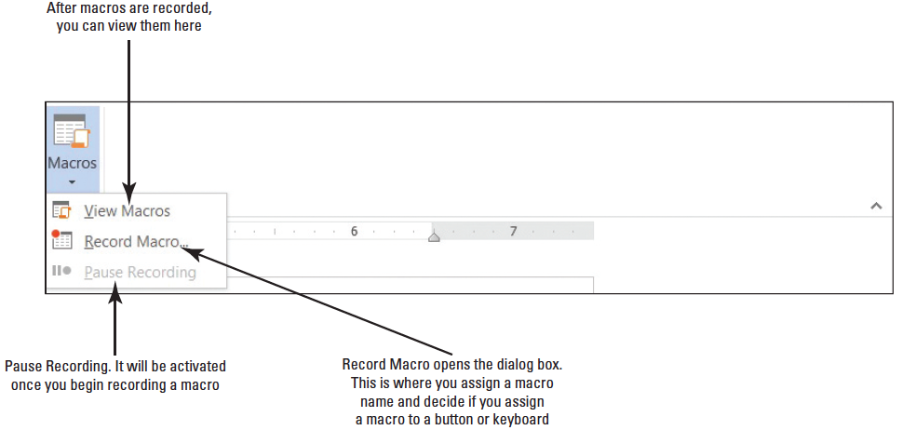
Step by Step: Assign Shortcut Keys
OPEN a blank document.
In the View tab, click the drop-down arrow by Macros to produce a menu (below).

Slide 32
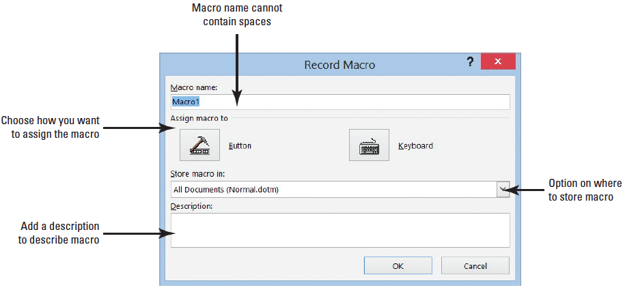
Step by Step: Assign Shortcut Keys
Click Record Macro to open the Record Marco dialog box. In the dialog box, you need to assign a name to the macro and decide which option to use to assign a macro. You have two choices as shown below. You can assign a macro by button or by keyboard.

Slide 33
Step by Step: Assign Shortcut Keys
In the Macro name box, type Upcoming_Workshops. Spaces are not allowed; you need to add an underscore. Adding a number at the end of the macro name is also valid.
Keep the default to Store Macro in. It will be stored in All Document (Normal.dotm). You want it stored there because you will access this macro on a monthly basis. If someone else is working on your computer and you’ve provided this person with the keyboard shortcut, he or she too can access the macro. (Hint: You can add the shortcut key in the description, in case you forget it or want to share it.) The first macro will be assigned to a keyboard command. This means whenever you press the keyboard commands, the macro will run. Before you click the Keyboard button, you want to add a description to the macro.

Slide 34
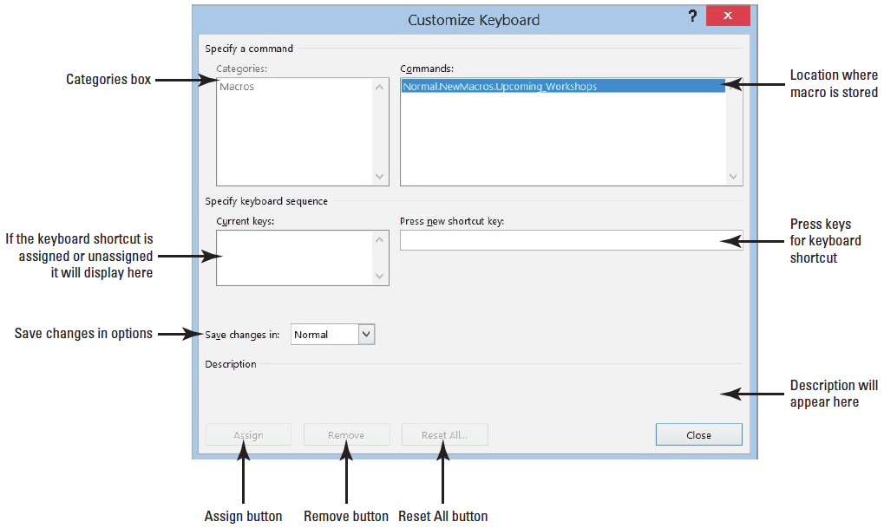
Step by Step: Assign Shortcut Keys
In the Description box, type Use this table for all upcoming workshops.
Click the Keyboard button to open the Customize Keyboard dialog box as shown below.

Slide 35
Step by Step: Assign Shortcut Keys
In the Commands box, the macro is stored in Normal.NewMacro.Upcoming_Workshop. This shows the location of where the macro will be stored.
It’s time to see whether a keystroke has been assigned to another command. In the Press new shortcut key box, press Ctrl+T (do not type the plus symbol).
This shortcut key is already assigned to the HangingIndent command as shown in the dialog box.
Press Backspace to remove Ctrl+T.
Let’s try another shortcut key.
Press Ctrl+Alt+T.
And again, this shortcut key is already taken by the ™ Trademark command. It may take you several attempts to find an unassigned shortcut key.
Press Backspace to remove Ctrl+Alt+T.

Slide 36
Step by Step: Assign Shortcut Keys
Press Alt+T. Notice that this keystroke is not assigned.
Click the Assign button to assign this shortcut key to the new macro. The Alt+T command is moved to the Current keys box for this macro.
The changes will be assigned in Normal instead of Document1. This macro will be saved on the computer that you are recording the macro and can be accessed by anyone who is working on your computer.
Click Close.
PAUSE. LEAVE the program open for the next exercise.
Notes:
Take Note: Word allows you to override assigned keyboard keys, but you don’t want to do that. Find one that is unassigned.

Slide 37
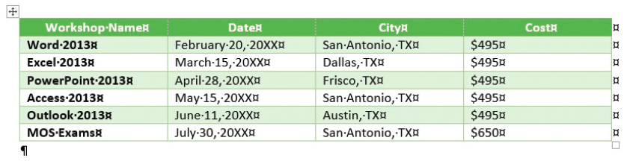
Step by Step: Record a Macro
Click the Insert tab, and then click Insert Tables to open the dialog box.
Create a table that contains 4 columns and 7 rows. Click OK.
Type the information as shown below. Because you are recording a macro, you need to press Tab to move between cells and press Shift+Tab to move back.
Notes:
Cross Reference: In Lesson 6, you learn to create tables using various methods and format using Tables Tools.

Slide 38
Step by Step: Record a Macro
After you type the data, click the Layout tab from the Tables Tools and Select Tables.While you are recording a macro, you cannot use your mouse to select text or tables. The whole table is now selected.
In the Table Styles group of the Design tab, click the More button to display the gallery.
In the Grid Tables group, select Grid Table 4 – Accent 6 to apply a style to the table. Use the arrow keys on the keyboard to move up to the first row that contains the headings.

Slide 39
Step by Step: Record a Macro
On the Layout tab, select Row, and then select Align Center. For now, these are the only changes you will record for this macro.
The next step is to stop recording. Click Macros, and then click Stop Recording.
You recorded your first macro and will be able to access it quickly. If you share your computer with another individual, this person too can use the keyboard shortcut to apply the macro as long as you provide him or her with the shortcut key. This table can be used for all upcoming workshops—all you have to do is change the data.
CLOSE the document without saving. (Hint: When a warning prompt appears, click Don’t Save.)
PAUSE. LEAVE the program open for the next exercise.

Slide 40
Step by Step: Run a Macro
Once a macro is recorded, you can enter the keyboard shortcut to run it in a blank or existing document.
OPEN a blank document.
Press Alt+T. The table automatically appears on your document screen.
When you need to work on this table, you can now access it quickly, edit the data, and then save with a new filename.
SAVE the document as Upcoming Workshops in the lesson folder on your flash drive, and then CLOSE the file.
OPEN a blank document. Now, let’s run the macro again another way.

Slide 41
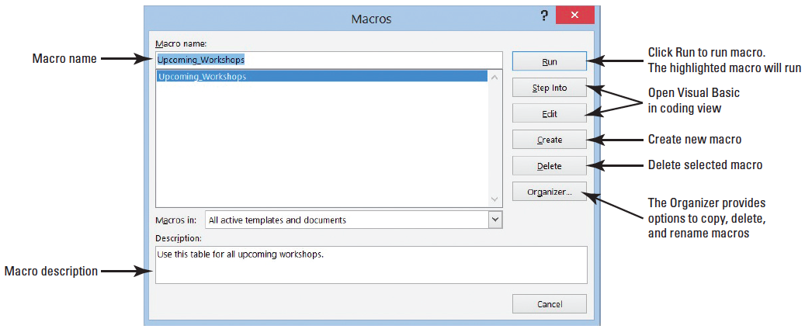
Step by Step: Run a Macro
Click View Macros to open the Macros dialog box as shown below.
Click Run. The table appears on the document screen.

Slide 42
Step by Step: Run a Macro
Additional commands are available in the dialog box and will not be discussed in this lesson.
Some of these commands open the Visual Basic Application—this is where you can create or edit a macro.
If you accidently open it, just close the application.
CLOSE the document without saving.
PAUSE. LEAVE Word open for the next exercise.
Notes:
Troubleshooting: Creating and running a macro takes practice. If your macro does not run correctly, delete the macro and repeat your steps from the beginning.

Slide 43
Step by Step: Delete a Macro
You determine you no longer need this macro and want to delete it. In this exercise, you learn to delete a macro.
OPEN a blank document.
Click View Macros to open the Macros dialog box.
Select the macro, and then click the Delete button.
A warning prompt appears asking Do you want to delete macro Upcoming_Workshop?
Click No. You can return later to delete.
PAUSE. LEAVE Word open for the next exercise.

Slide 44
Step by Step: Review Macro Security Settings
Macro security has preventive measures in place to determine whether a macro source is safe to run.
GET READY. If necessary, before you begin these steps, LAUNCH Word.
From the File tab, select Options on the Backstage page.
Select Trust Center from the Word Options dialog box.
In the Trust Center screen, Microsoft has provided links to articles on protecting your privacy, computer, and security. At your leisure, take time to read these articles.

Slide 45
Step by Step: Review Macro Security Settings
Click the Trust Center Settings button to open the Trust Center screen. In the left pane, Macro Settings is highlighted.
This is where you manage how macros run. You can choose to disable all macros with or without notification, disable all macros with the exception of those that are digitally signed, or enable all macros that could harm your computer.

Slide 46
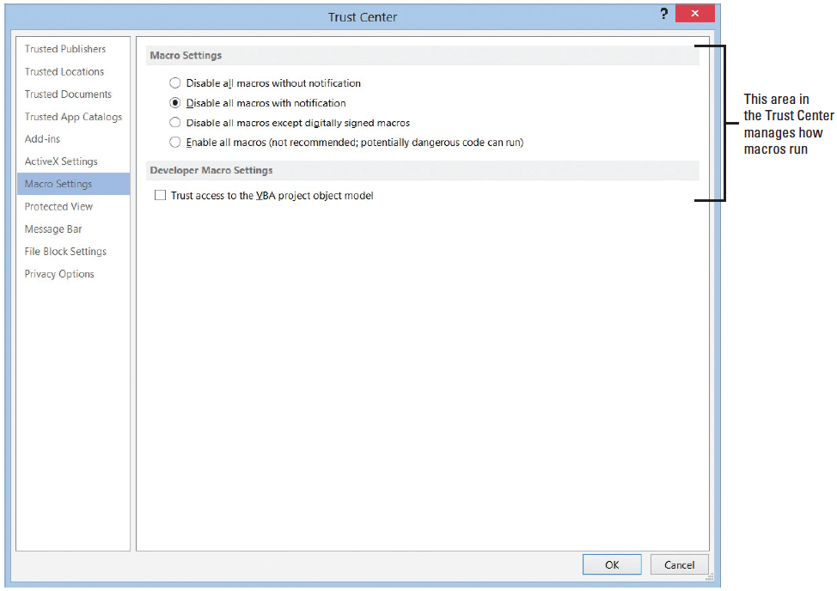
Step by Step: Review Macro Security Settings
Adding a check mark by Trust access to the VBA project object model allows access to the Visual Basic for Application object model. Leave the settings at the default settings (right).
Click the Cancel button to exit the Trust Center dialog box.
PAUSE. LEAVE the Word Options screen open to use in the next exercise.

Slide 47
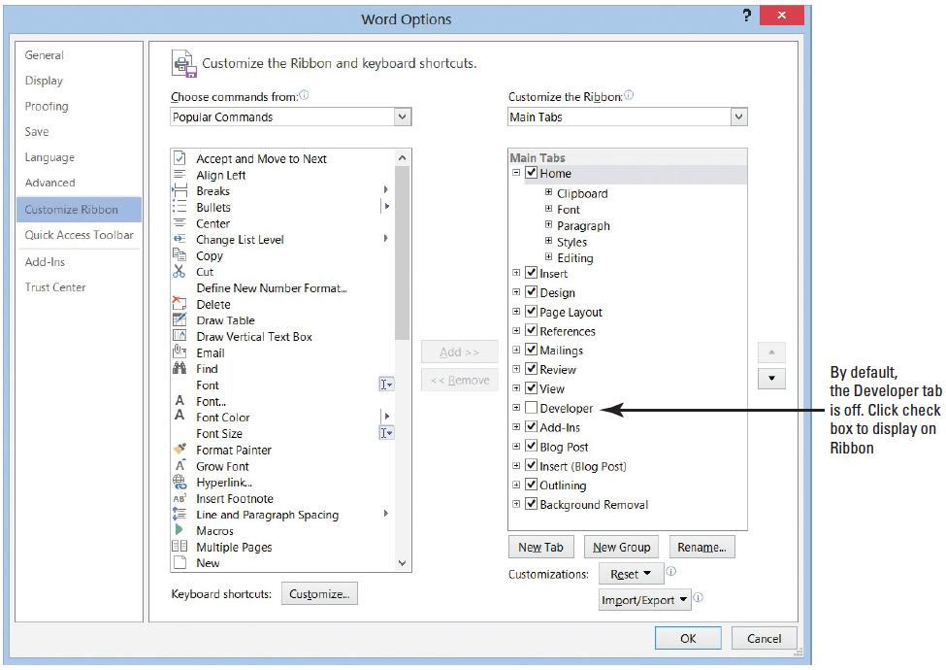
Step by Step: Review Developer Tab
Click Customize Ribbon on the right pane.
This screen is where you customize the Ribbon or, in this case, turn on a Ribbon that is off by default.
Under Customize the Ribbon, select the check box by Developer (above).
Notes:
Cross Reference: In Lesson 14, you learn to customize the Ribbon with your favorite commands.

Slide 48
Step by Step: Review Developer Tab
Click OK.
Click the Developer tab to display the groups and commands.
The Developer tab contains commands that are used with macros, which includes codes, templates, controls used in forms, add-ins, and more.
Previously, you opened the Macros dialog box to run a macro that you created. From the Developer tab, the Macro dialog box can be accessed in the Code group tab by clicking the Macros button.

Slide 49
Step by Step: Review Developer Tab
In the same group, you can record a macro and pause a recording—these are the same commands from the Macros group in the View tab.
Clearly the Developer tab contains more commands. The Macro Security button opens the Trust Center. This displays the macro settings for your computer.
If you have a programming background or feel comfortable writing codes, you can write your own macro using the Visual Basic editor.
CLOSE Word.
Notes:
Take Note: To find additional information on macros, use the Help feature by pressing the F1 button or click the Help icon.

Slide 50
Skill Summary

